Slide 1
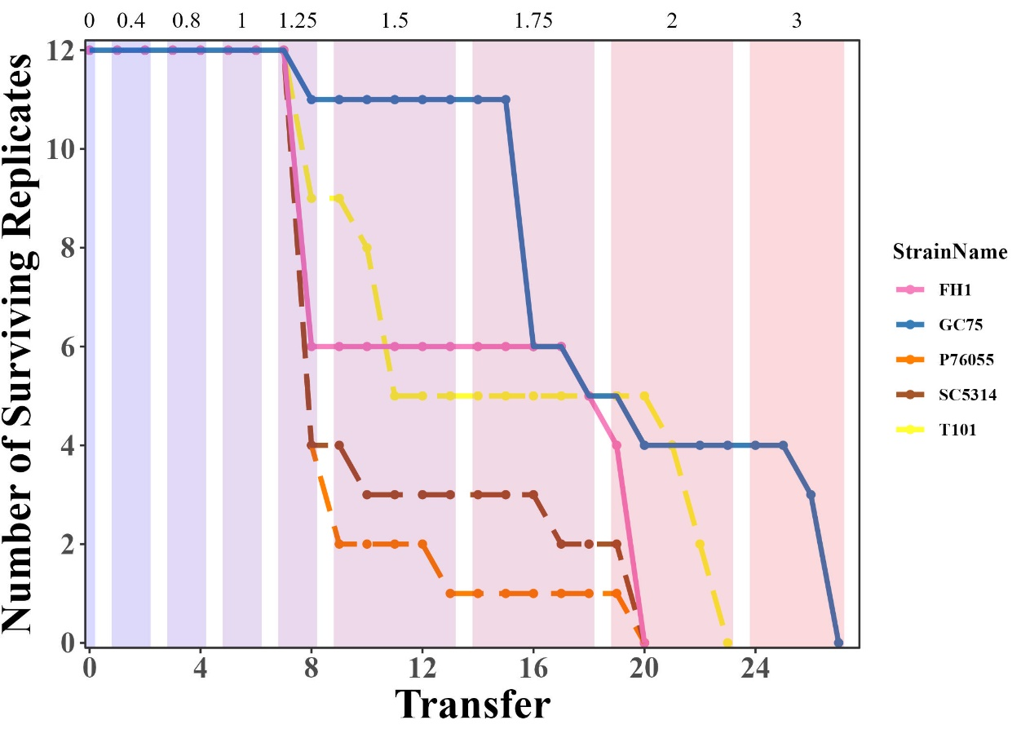
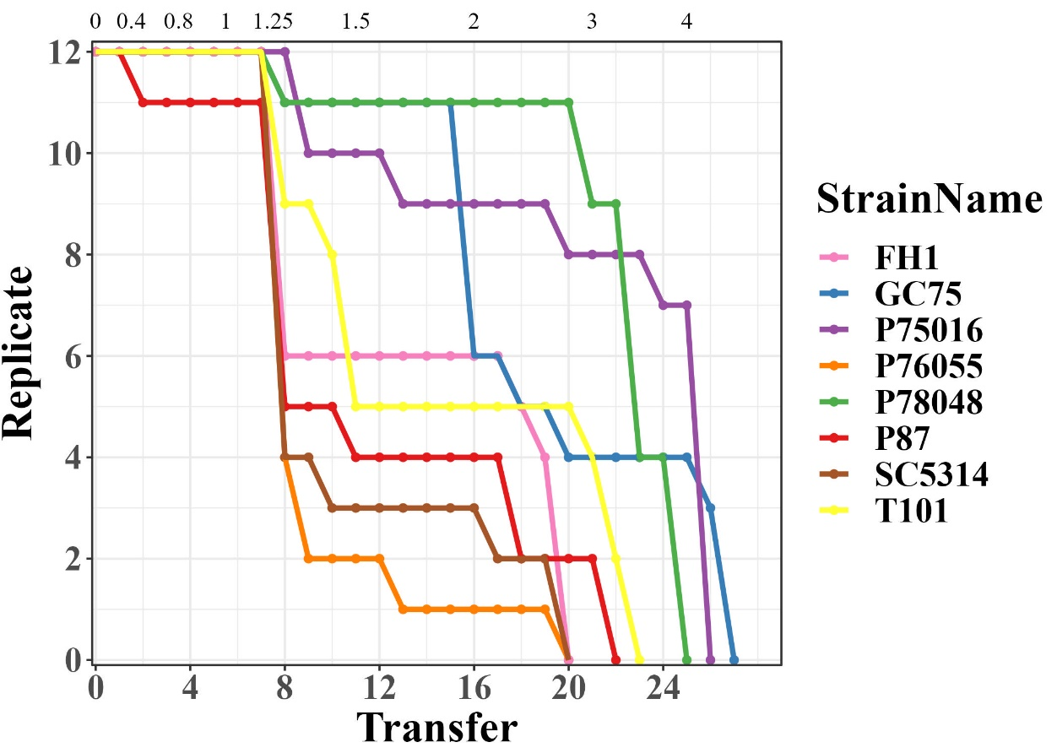
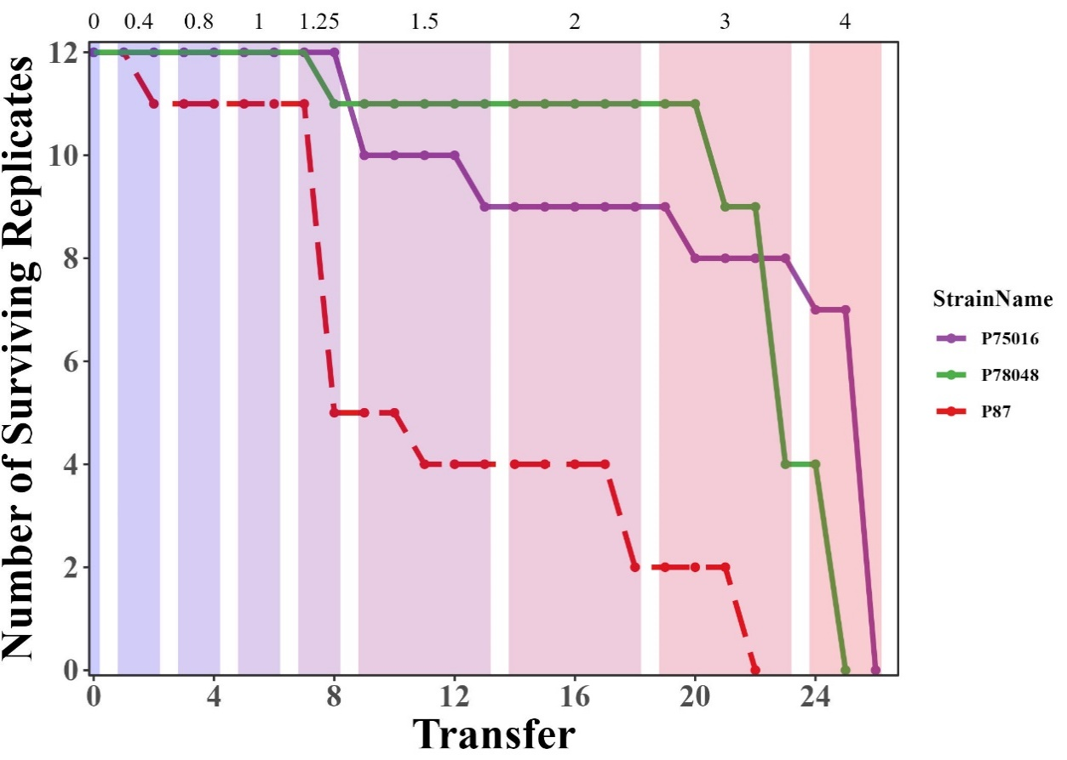
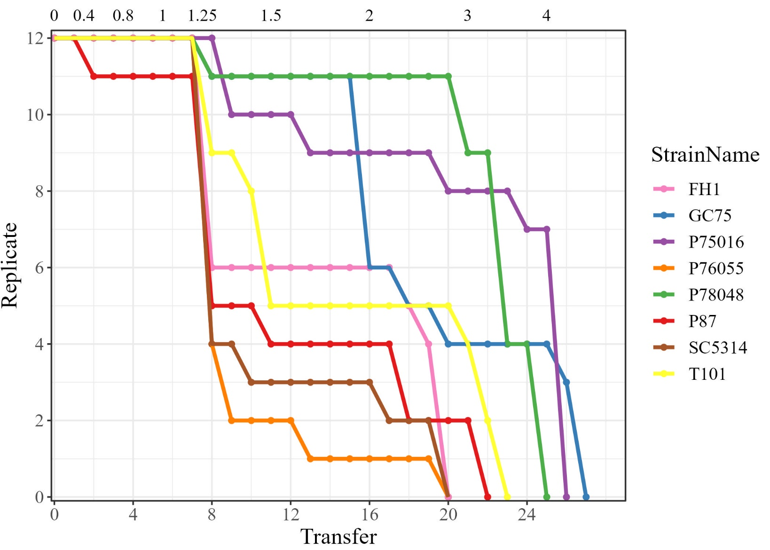

Group A
Group B

Slide 2
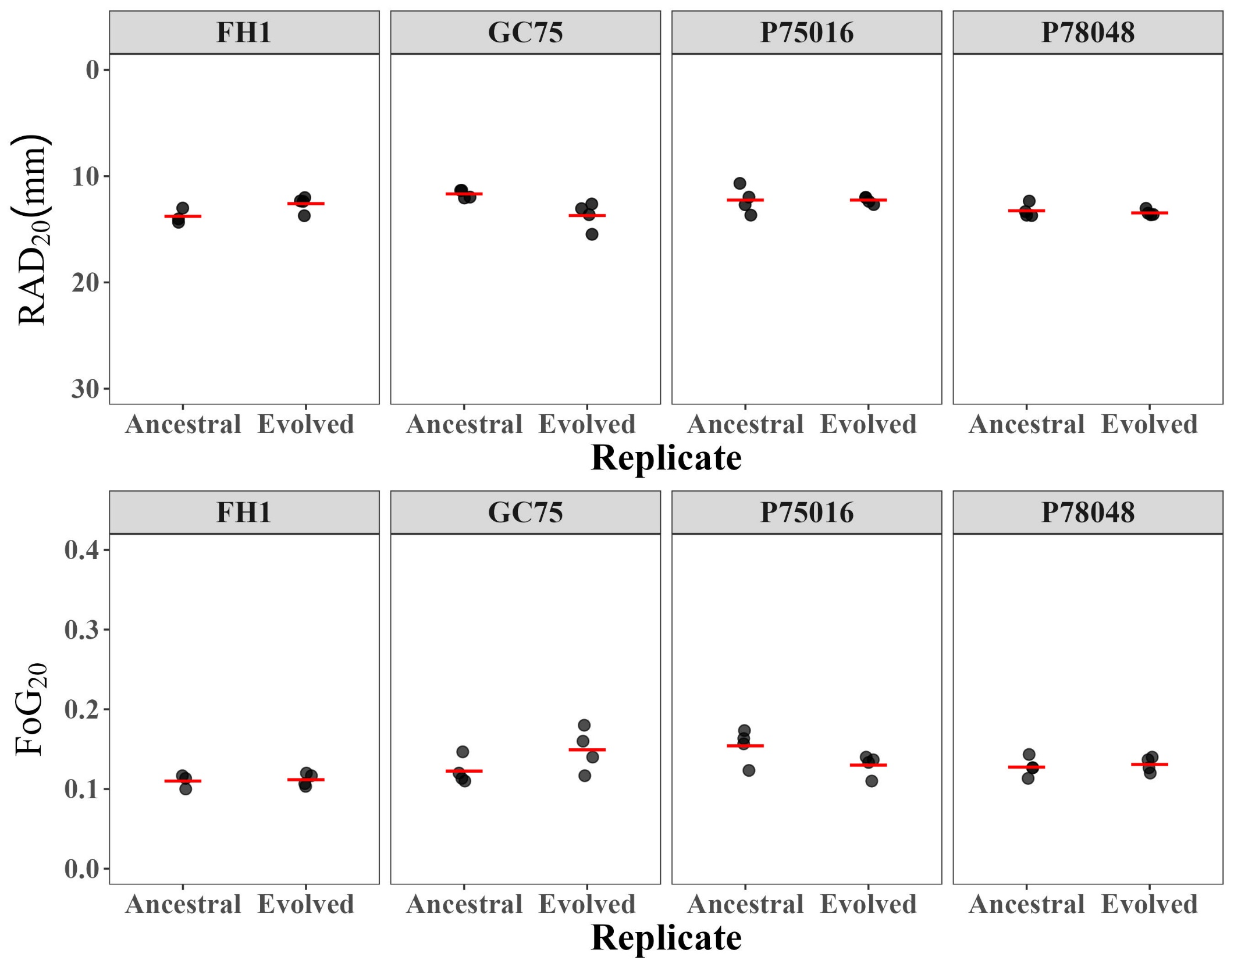
Group A
Group B
a)
b)

Slide 3
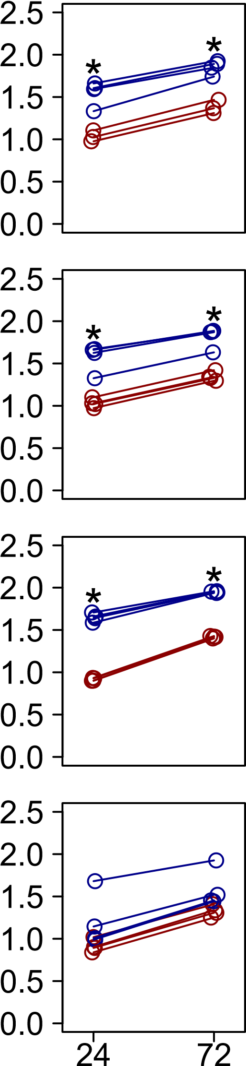
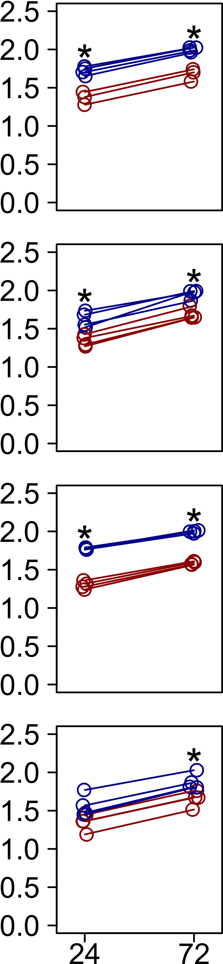
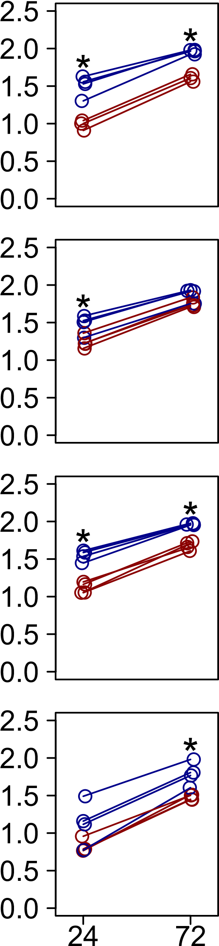
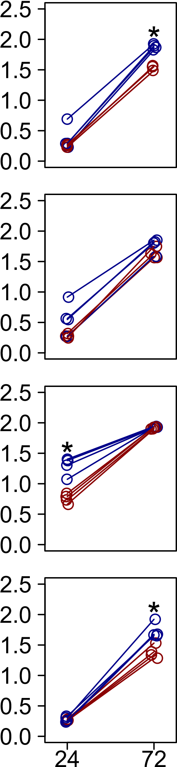
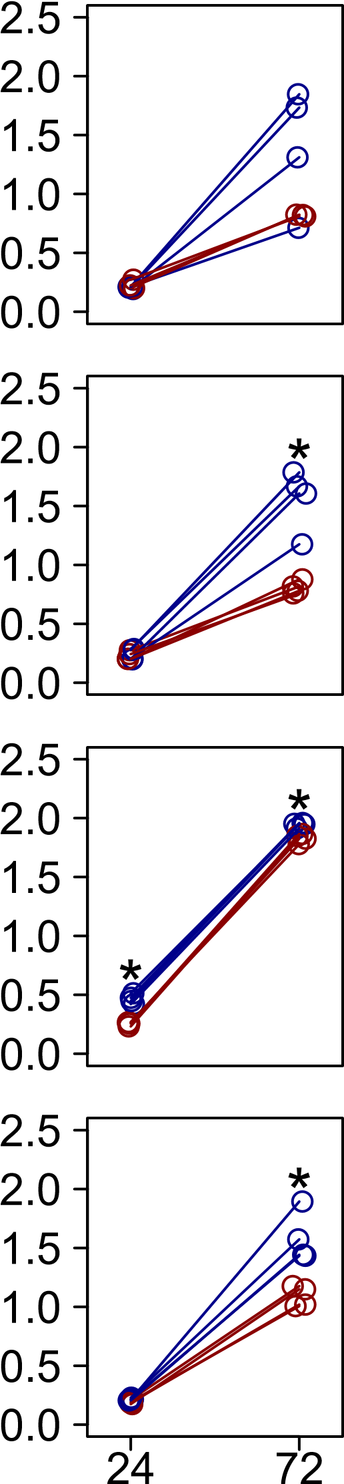
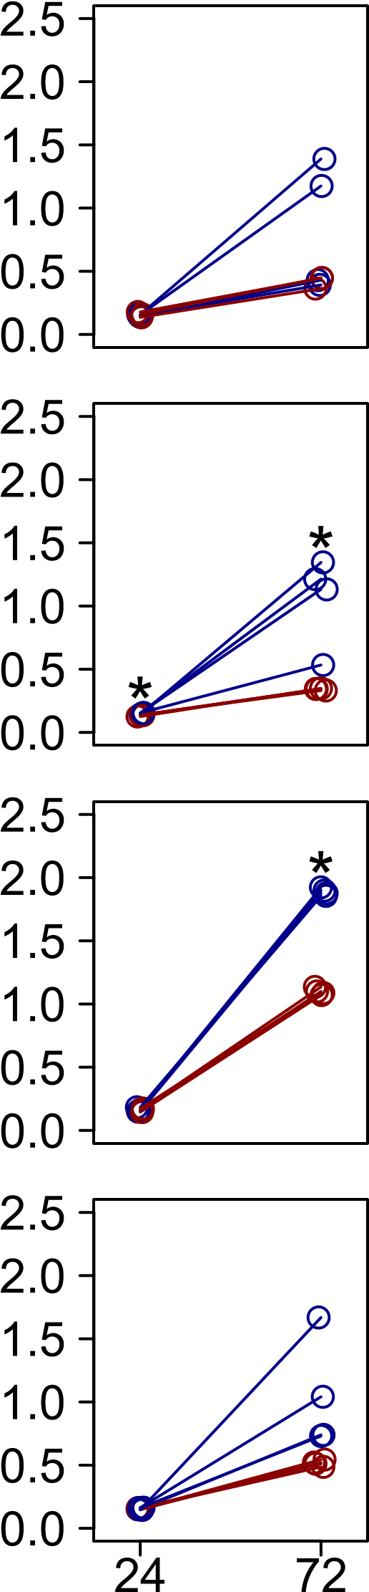
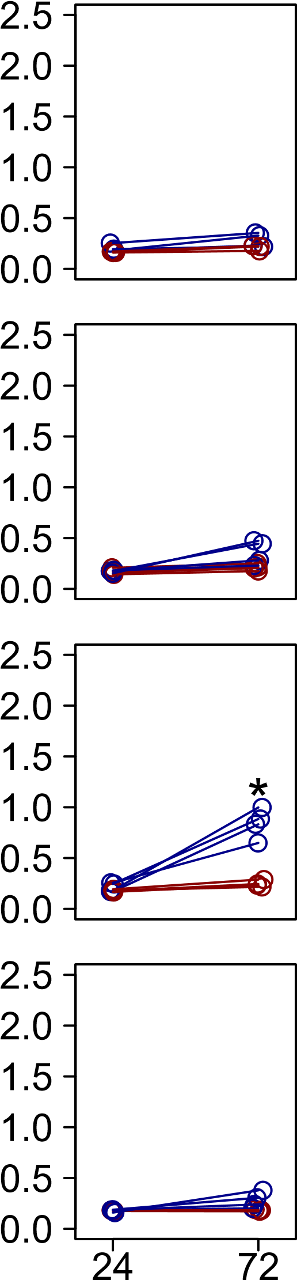
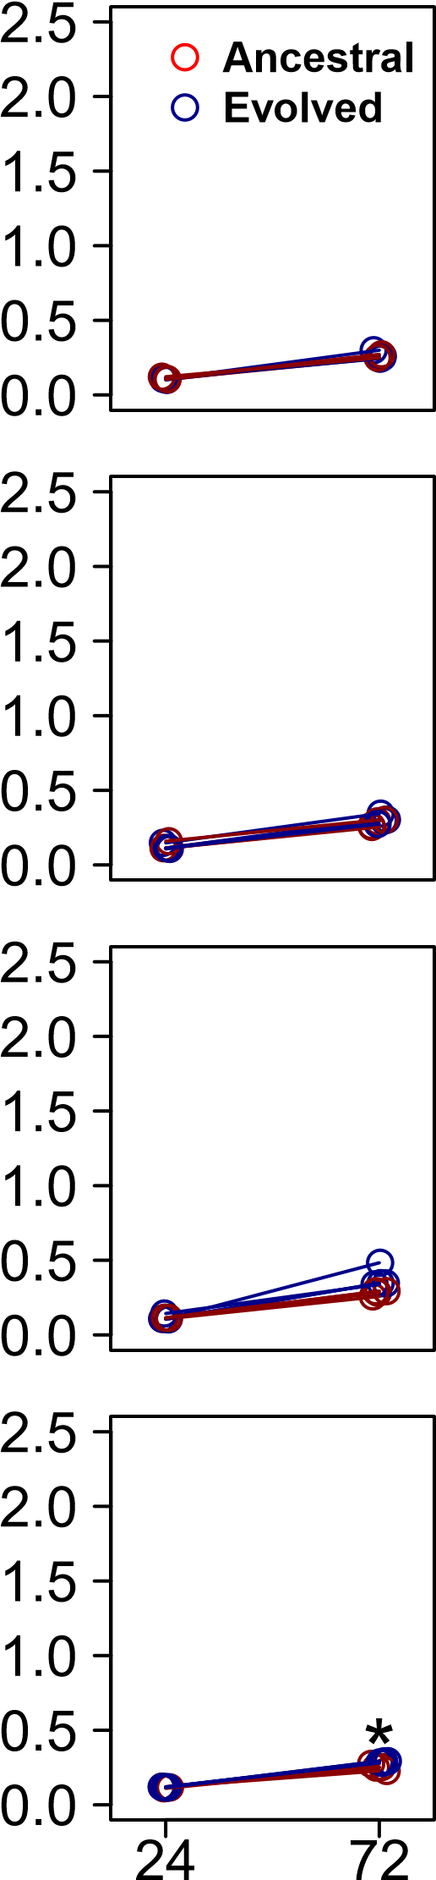
0
0.2
0.4
0.8
1
1.25
1.5
1.75
FH1
Group A
GC75
Group A
Optical Density (OD₆₀₀)
P75016
Group B
P78048
Group B
Time of Reading (h)
Notes:
Figure 3. Fitness of ancestral and evolved replicates grown in RPMI and increasing concentrations of BA. Optical density was measured at 24 h and 72 h. Ancestral replicates are shown in red, evolved replicates are shown in blue. Stars indicate statistical significance in a t-test comparing ancestral and evolved replicates at one time point (24 h or 72 h of growth).
72h unmixed

Slide 4
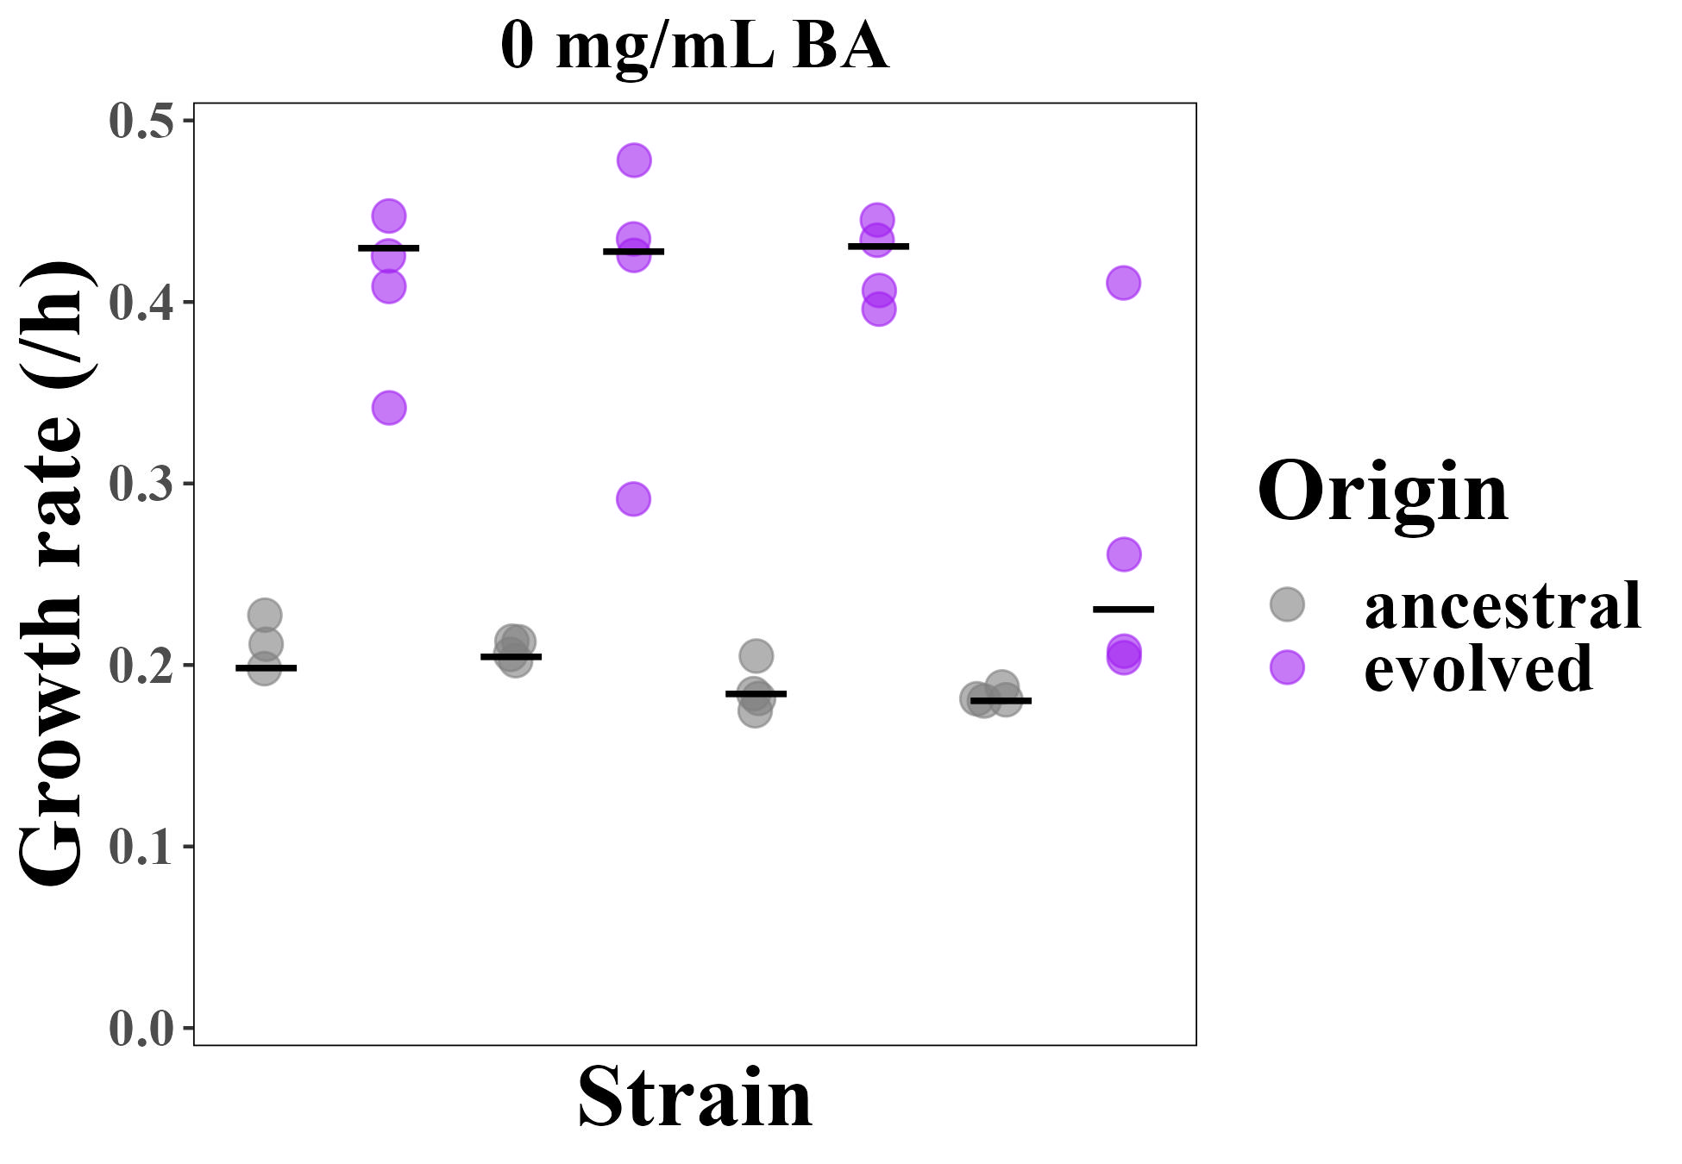
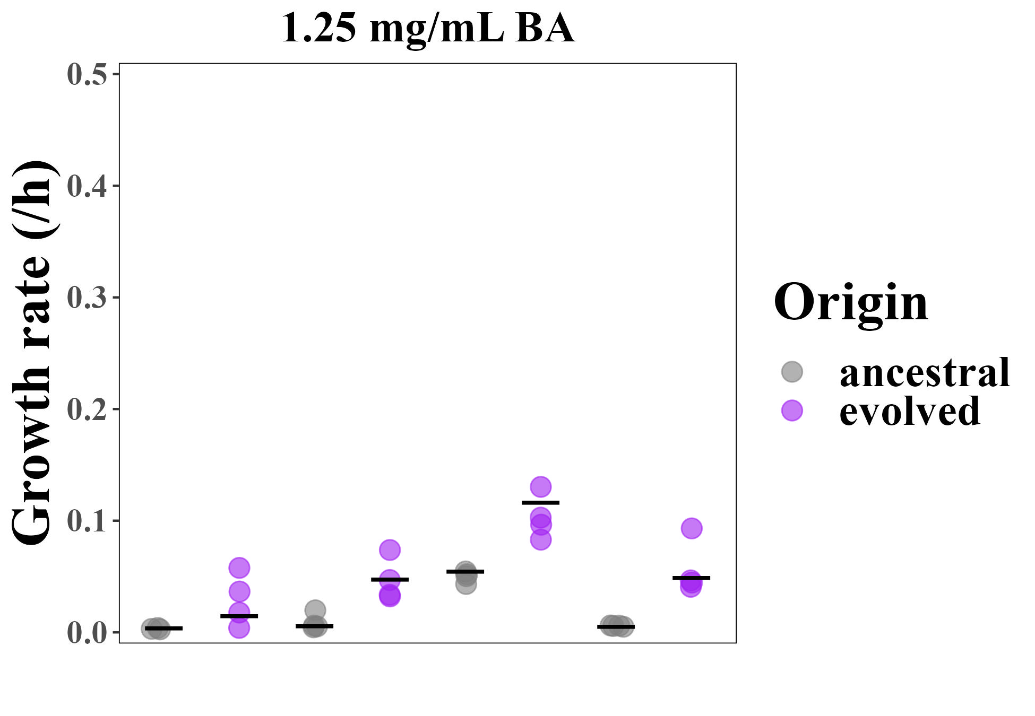

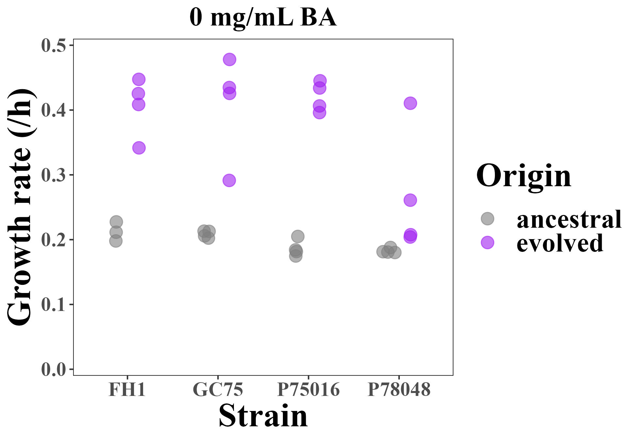
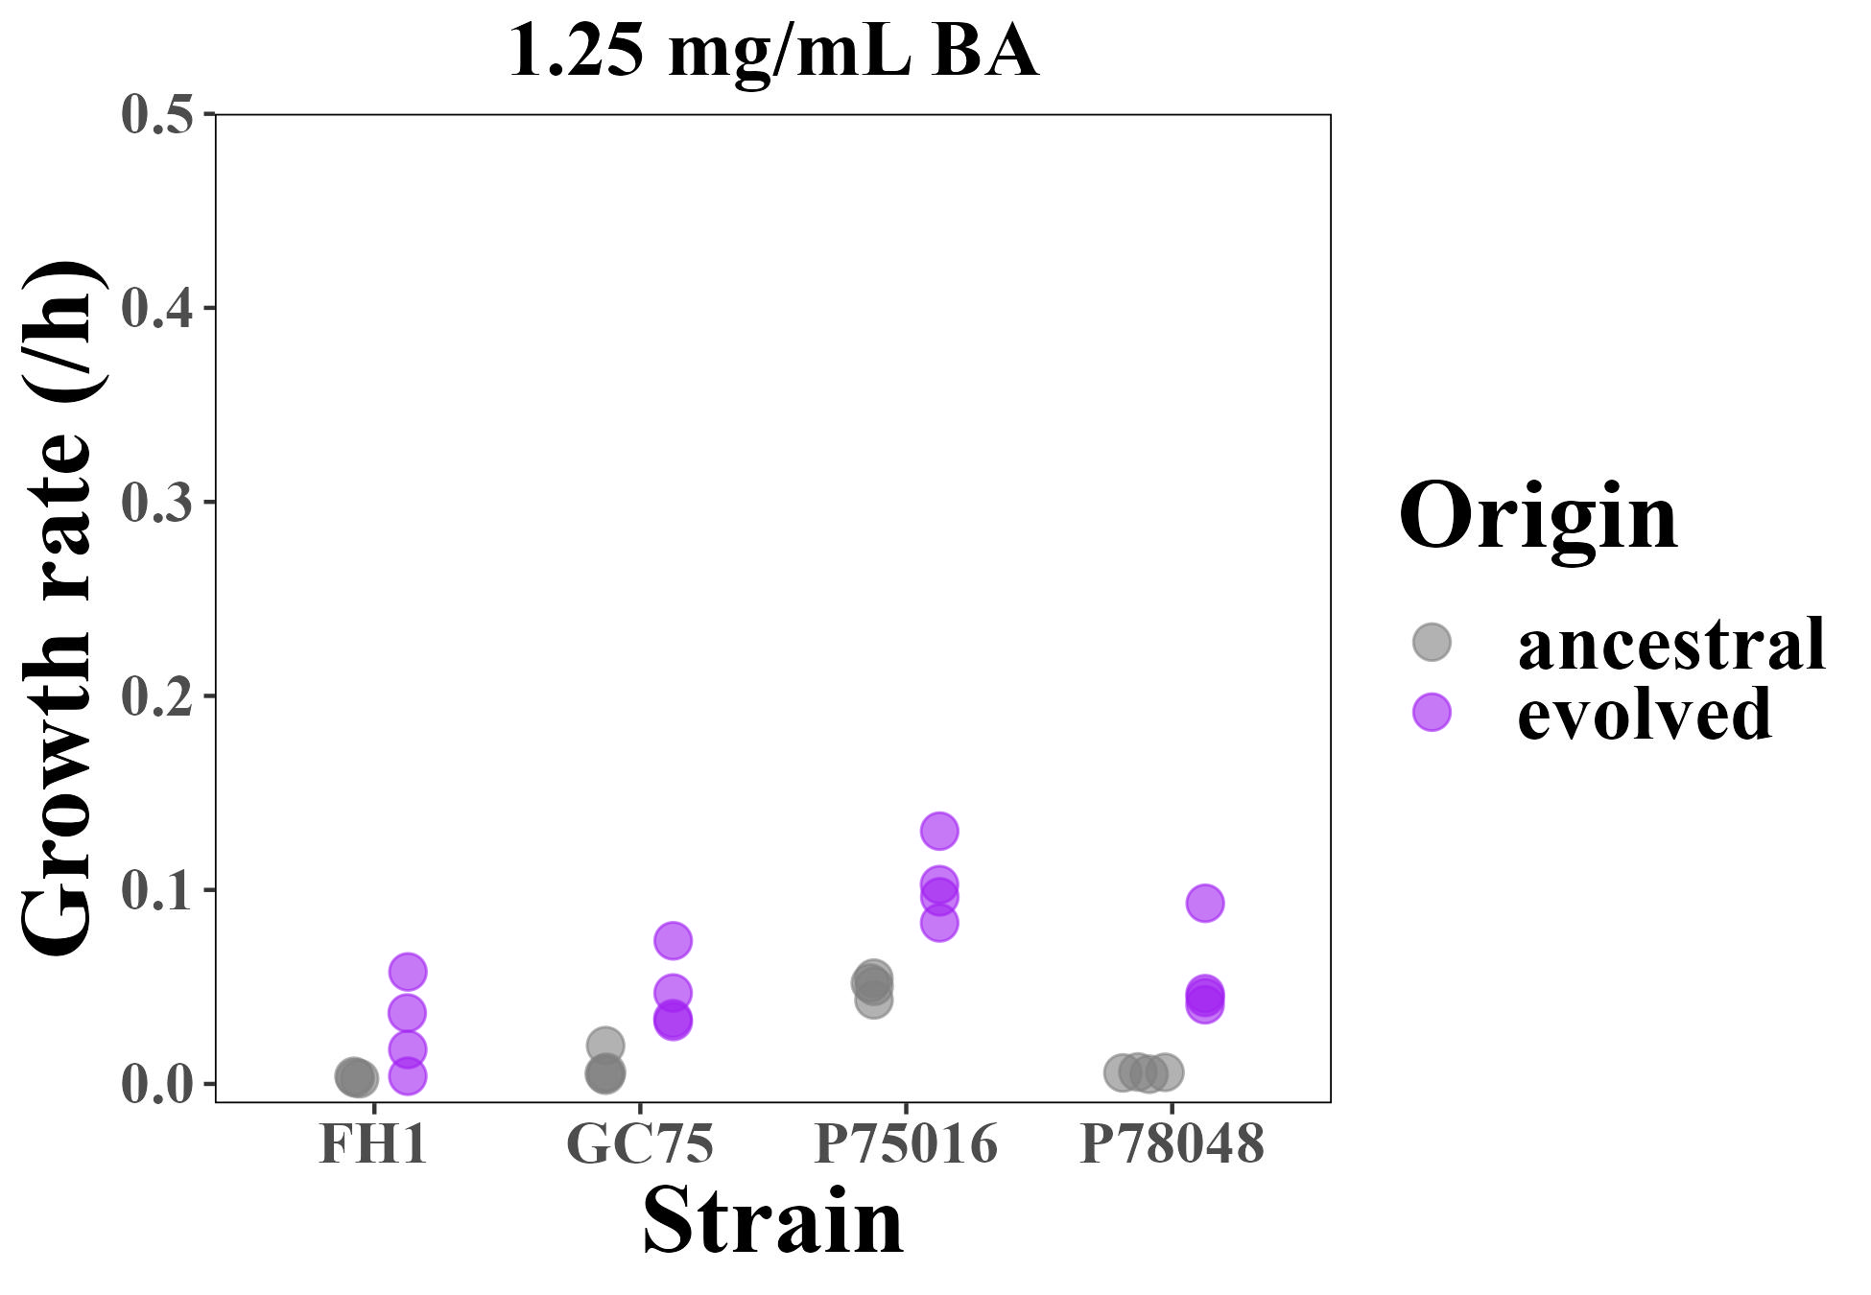
a)
b)
*
*
*
*
*
Group A
Group B
Group A
Group B

Slide 5
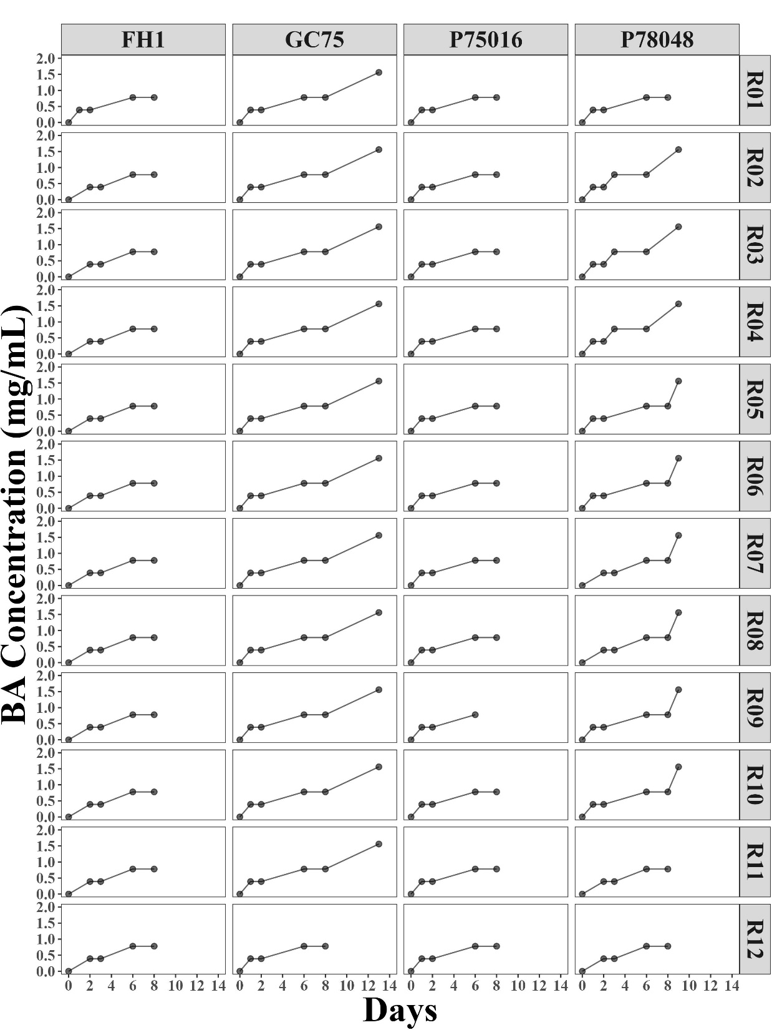
a)

Slide 6
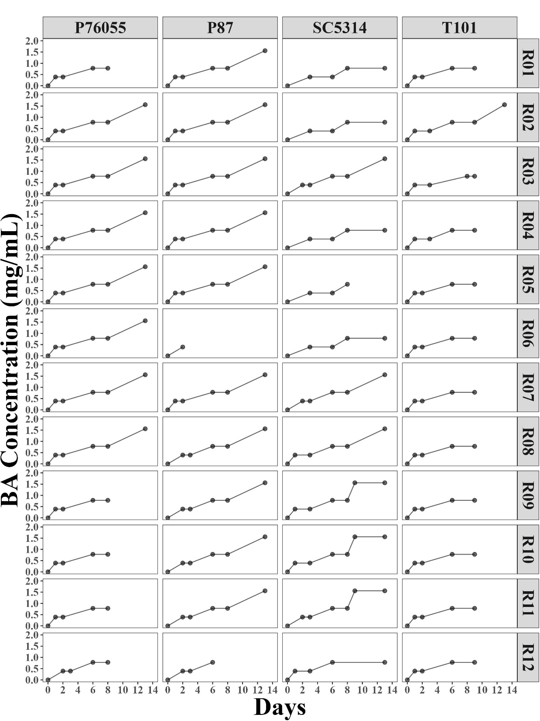
b)

Slide 7
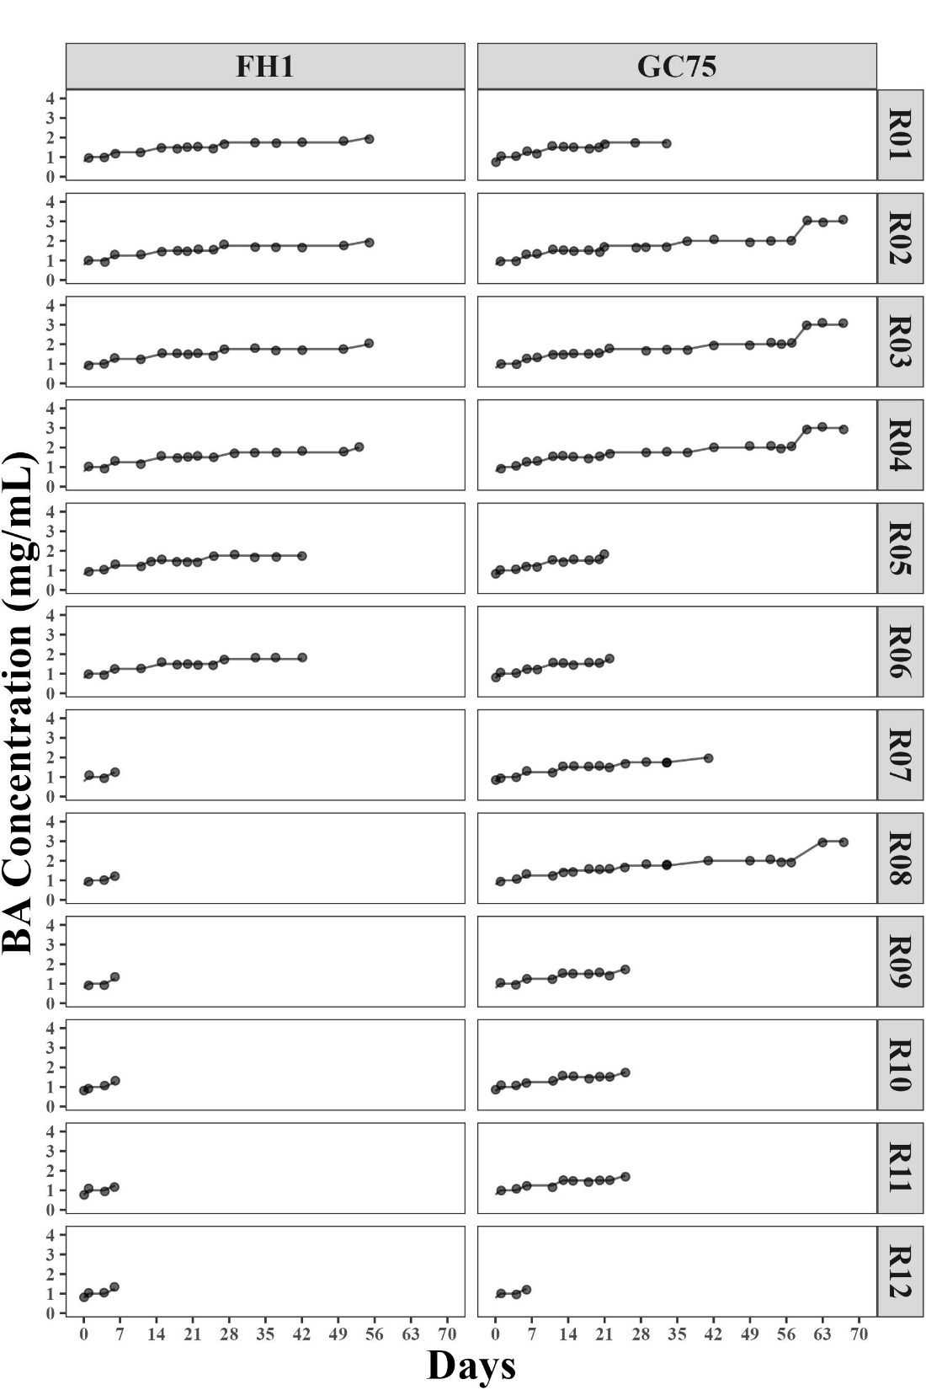
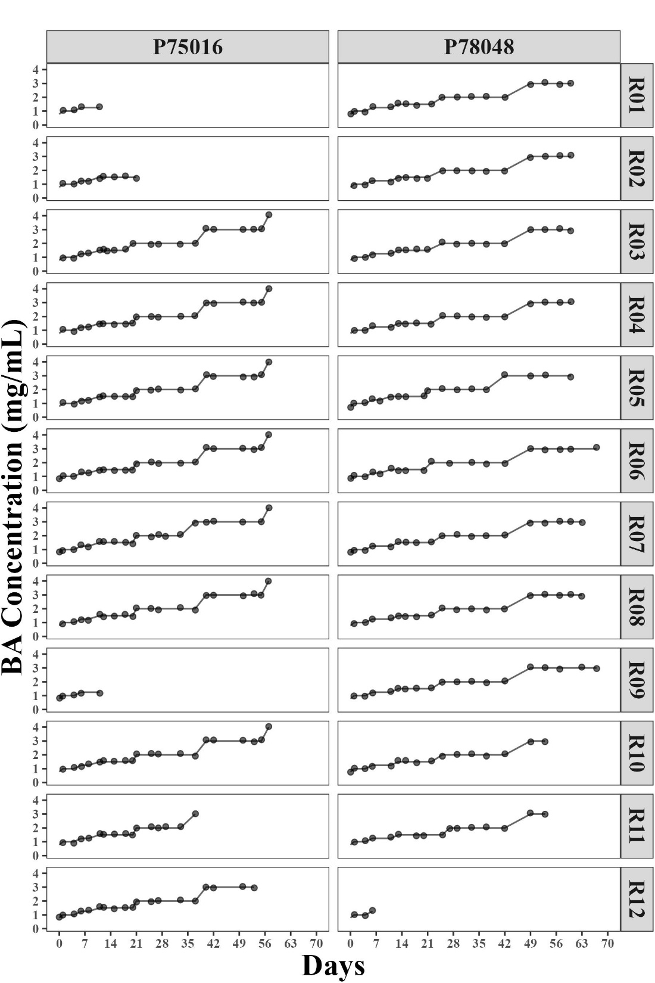
a)
b)

Slide 8
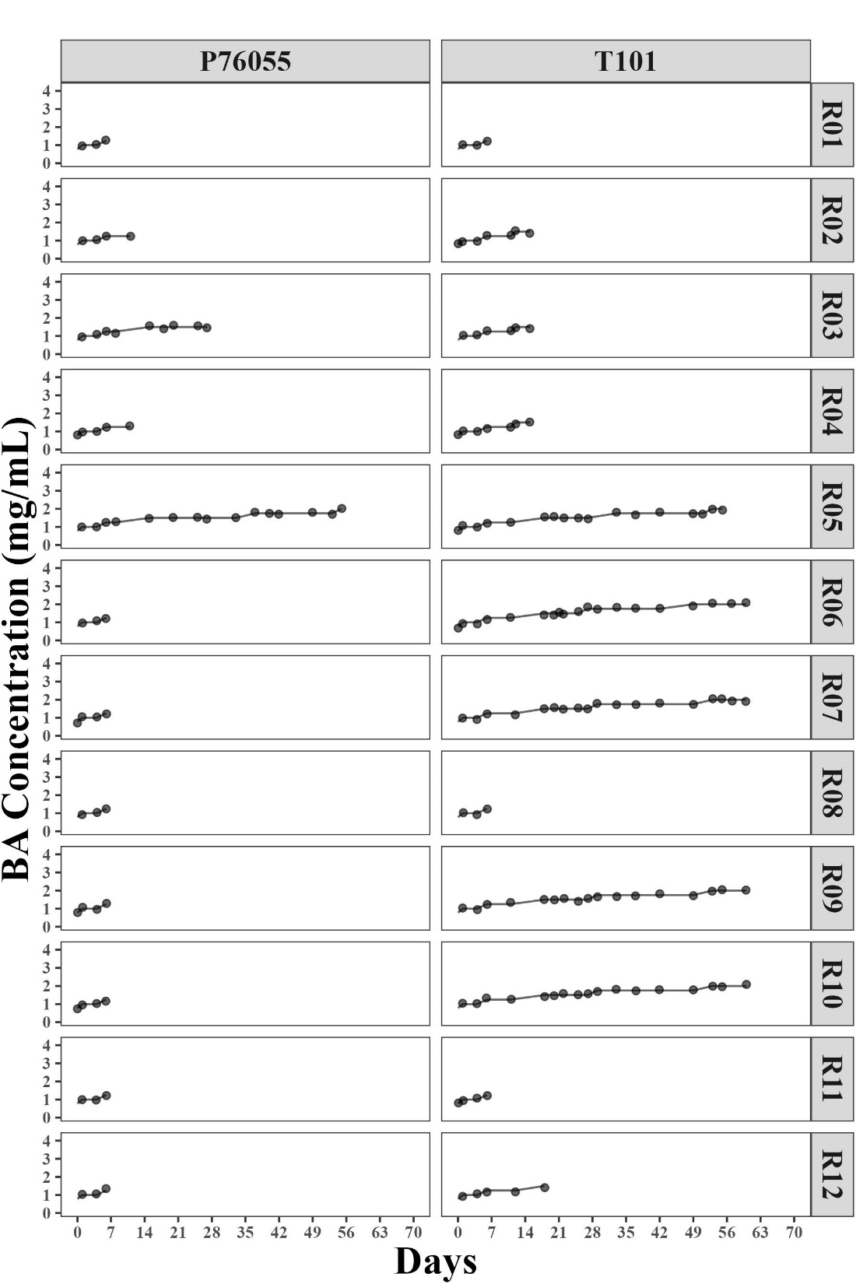
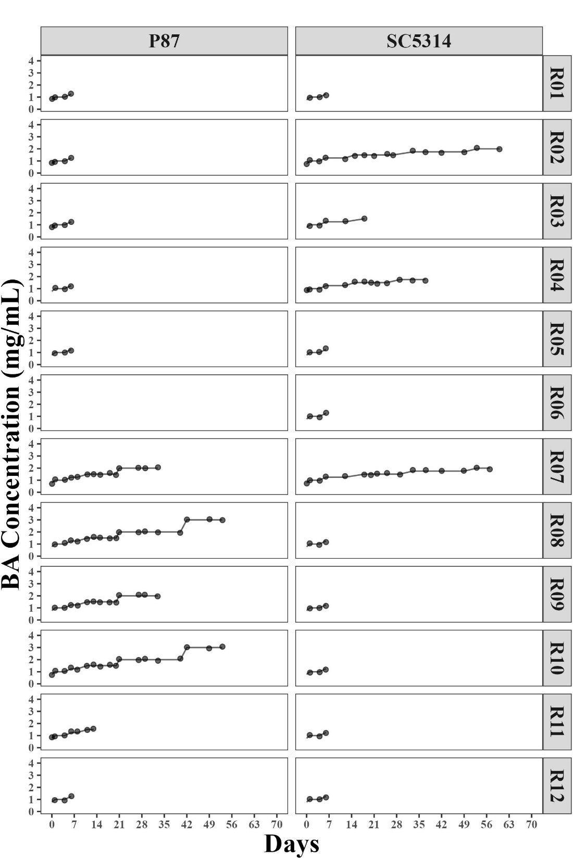
c)
d)

